Slide 1
Lewis Fox Racing
2016 Mini 7 Championship
Partnership Proposal

Slide 2
The Championship
Overview:
The Mini7 Championship is the longest running single make series in the UK, having celebrated its 50th anniversary in 2015. Widely known as the most competitive club championship in the UK, the Mini 7’s have seen a number of current professional Drivers starting there circuits careers in the class including 2015 Lemans 24 Hour Winner Nick Tandy and Multiple British GT Champion Andrew Howard.
Media Reach:
6 Televised rounds ( 2 Live)
2015 Mini Festival Attendance:
Brands Hatch: 10,000
Oulton Park: 5,000
Club Social Media:
Facebook Likes: 5,382*
Twitter Followers: 2,053*
2016 Calendar:
Castle Combe Easter Bank Holiday 28th March
Brands Hatch GP British GT Support 17th April
Cadwell Park Race day 14/15th May
Donington Park Motors TV Race day 19th June
Brands Hatch Mini Festival 16/17th July
Oulton Park Mini Festival 20th August
Snetterton Race Day 10/11th September
Zandvoort British Festival 1/2nd October
* Figures accurate on 18th January 2016

Slide 3
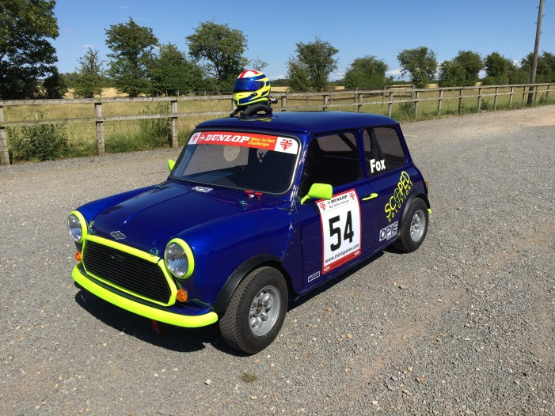
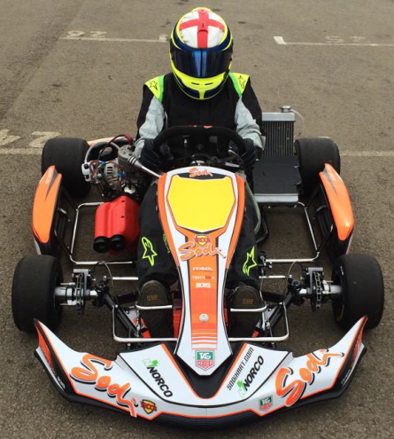
The Driver
The Car
Having had a passion for Motorsport from a young age. I was finally able to compete in club level Karting when I turned 16, with varying success including winning the Novice TKM Clubman Super prix. I regularly practice in a short circuit Gearbox Kart, this experience has enabled me to hone my race craft before stepping up to racing cars. I Joined the Mini 7 Championship for the last two rounds of the 2015 Championship. Securing two top 15 finishes resulting in winning the Novice Championship. With a number of planned tests during the winter to continue my personal development my aim for next year is to consistently compete for top 10 finishes and a top 10 finish in the championship.
I started the build of the car from a bare shell in December 2014. Every aspect of the build was completed by myself and the team. Working tirelessly during the winter and spring months, the car was completed in July 2015. After a successful 2015 debut the, during the winter the car will under go a number of upgrades to ensure maximum performance and reliability.

Slide 4
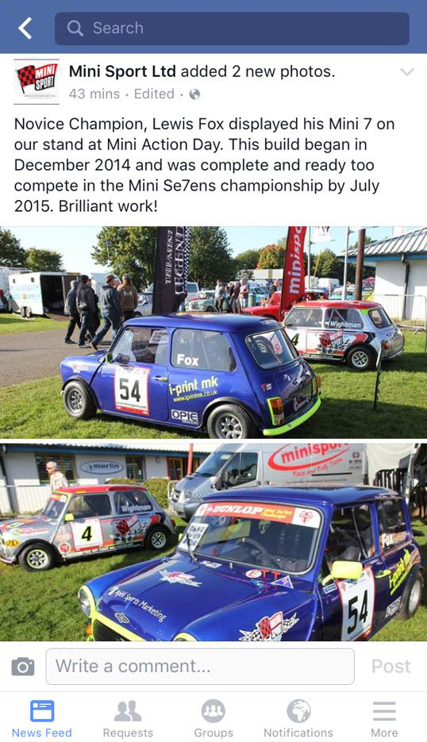
Partnership benefits
TV Coverage: The Championship will include two televised Mini Festivals. These two events will be Shown on Motors TV at various times after the events.
Brand Exposure: Partners will receive a number of opportunities for high profile branding on the car, team clothing and associated equipment.
Image use: The championship employs a dedicated professional photographer to ensure a number of high quality images are available for all partners after each race event, on top of this Video footage from the car may be provided on request for use in promotional items.
Event Tickets: Partners are invited to join the team at a number of events throughout the year with the potential to entertain guests with access to Meet & Greet sessions and hospitality.
Car Availability: The car will be available for presentation at partners corporate events and exhibitions.
Brand endorsement & product placement: During events, The team will ensure maximum brand endorsement with the option of sample availability and product offers. The team will also ensure any products supplied are neatly presented and correctly used to ensure maximum brand exposure
Local Media Coverage: During the Season, Race reports will be published in a number of Buckinghamshire Newspapers, these will include images and where possible partner information.
Indirect Brand Exposure: MiniSport LTD will continue to support my program throughout 2016, with race review blogs and updates on there social media and websites, Partners will enjoy Indirect exposure to over 10,000 people.

Slide 5
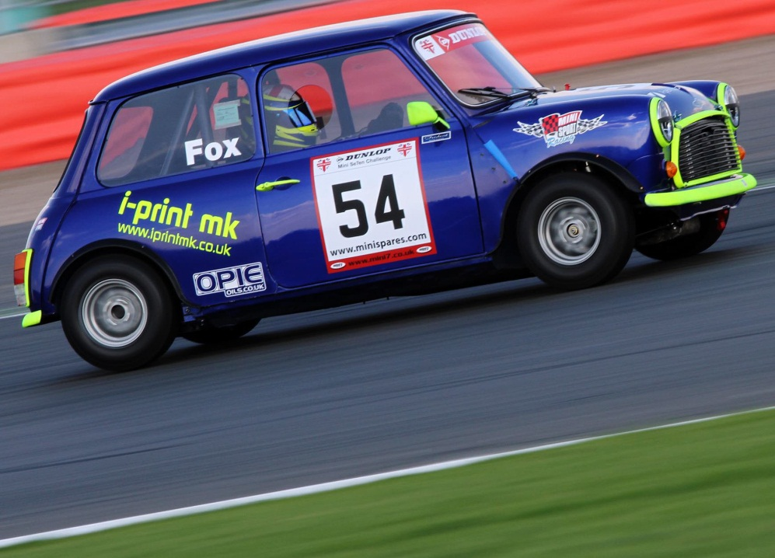
Next Steps
Thank you for taking the time to consider this proposal. If you would like to discuss this proposal in more detail or require more information, please do not hesitate to contact me on the Details below. I look forward to hearing from you.
Email: Lewisfoxracing@gmail.com
Telephone: 07903 727700

